Slide 1

mHealth Database
Corey Bright
Elijah Chong Tay
Hannah Applebaum
Harpreet Bains
Faizan Rafieuddin
Adesh Rai

Slide 2
Background Information

Slide 3
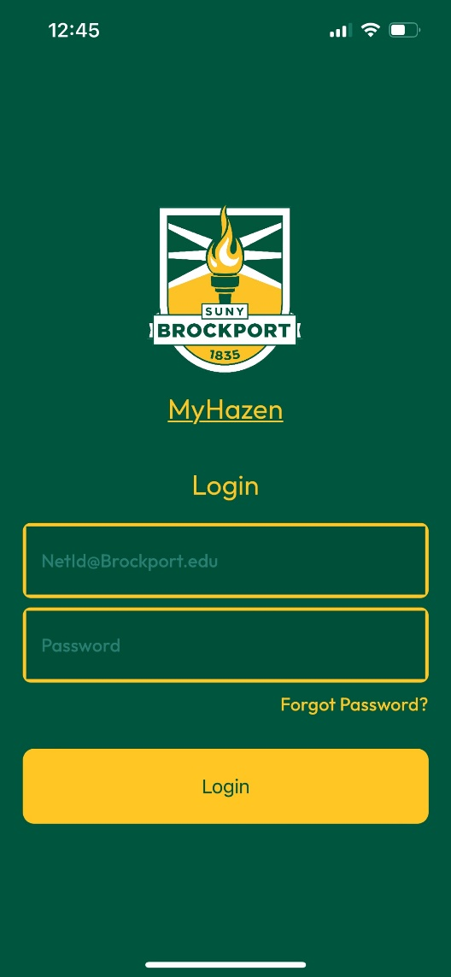
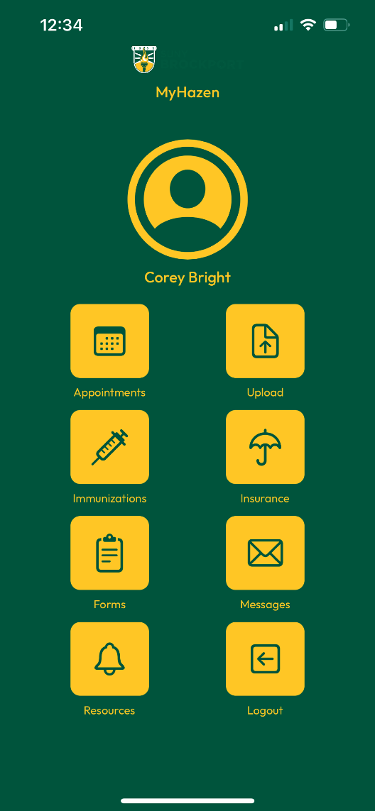
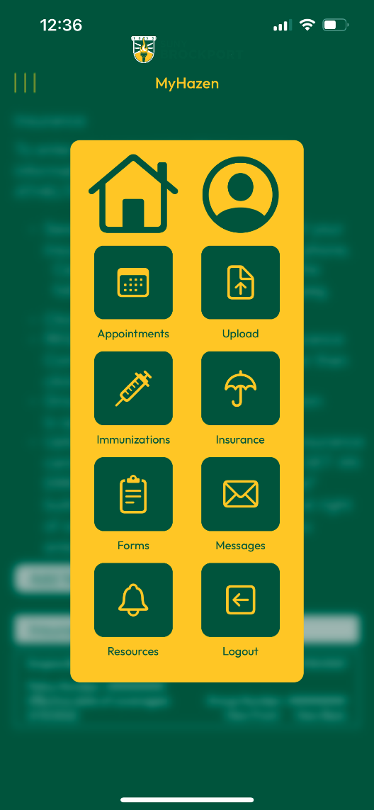

Slide 4
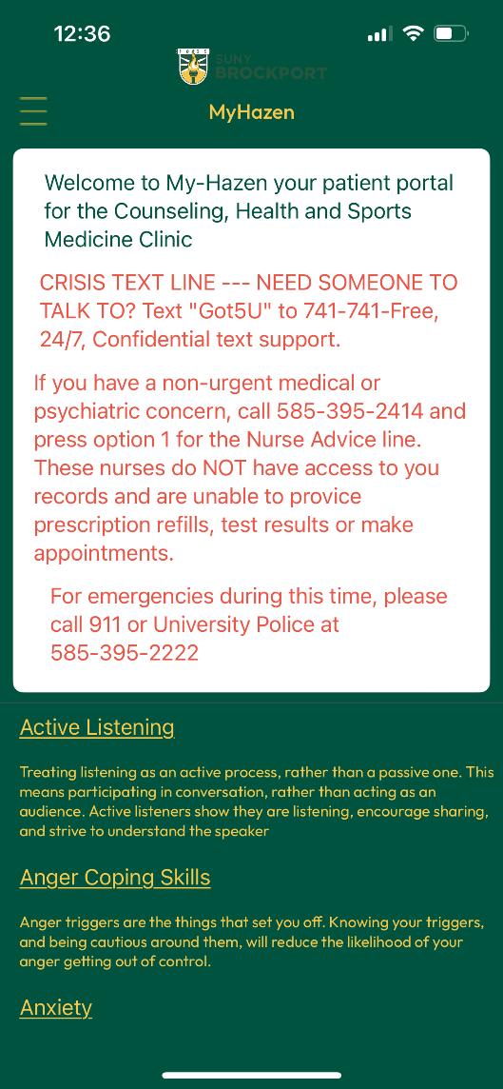
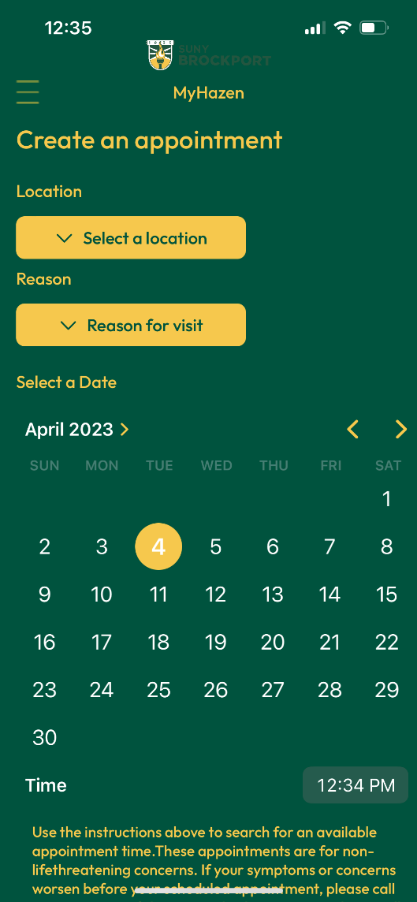

Slide 5
Statement of objective
The Database system we will be working on is related to the Hazen Health Portal. It would facilitate the operational team at Hazen to store health-related information allowing more functionality to the simple frontend that has already been designed.
This database will allow for better health care by improving all aspects of patient care, including effectiveness, patient-centeredness, communication, efficiency, and equity. This database will contain information related to patients i.e., college students and teachers.
It will have tables that store appointment times and dates. It will also have tables that have all the patient information relating to medicines, allergies, personal information, disabilities, emergency contacts, vaccinations, etc.
Notes:
maybe take this out
This database can potentially carry health documents that will facilitate the protection of the programs, the patients, and the insurance providers. It can potentially have separate tables relating to the patient table that carry information about primary health care providers, and insurance providers. Moreover, it can also have a table that logs overall attendance, check in, and check out times of students and faculty for appointments. It can potentially have a table that carries results and related documentation for pupils who took different medical tests at the center.

Slide 6
REQUIREMENTS

Slide 7
The database must have functionalities that enable a patient to schedule appointments with no overlaps at the same time between different patients and the same patient. Moreover, all times should be within bounds.
The database must allow patients to cancel and reschedule appointments based on the situation.
The database must provide functionalities that enable the staff at the Hazen Health Center to retrieve and inspect information regarding the patients, appointments, when required and according to their respective roles.
The database must contain the information related to doctors currently working at the Hazen Health center along with their specialization and availability throughout the day.

Slide 8
The database must contain immunization, insurance, and medication information for the patients and all these should be within bounds provided.
The database must allow multiple medications, immunizations, and insurances for a patient as there is a possibility that these fields have multiple entries.
The database must allow two-way communication between the patients and the employees of the Hazen Health Center via messaging.

Slide 9
Schema

Slide 10
person (person_id: INT, first_name: STRING, middle_initial: STRING, last_name: STRING, date_of_birth: DATE)
Keys: {person_id}, {first_name, last_name, date_of_birth, address}
phone_number (person_id: INT references person, phone_number: INT)
Keys: {person_id, phone_number}
patient (patient_id: INT reference person(person_id), password_hash: BINARY(64), school_email: varchar(50))
Keys: {patient_id}
doctor (doctor_id: INT reference person(person_id), primary_id: VARCHAR(50), secondary_id: VARCHAR(50))
Keys: {doctor_id}

Slide 11
specialty (doctor_id: INT references doctor, specialty: STRING)
Keys: {doctor_id, specialty}
doctor_availability (availability_id: INT, doctor_id: INT references doctor, availability_date: DATE, start_time: TIME, end_time: TIME)
Keys: {doctor_id, specialty}
employee (employee_id: INT reference person(person_id), job_title: STRING, start_date: DATE, end_date: DATE, employee_email: VARCHAR(50), secondary_email: VARCHAR(50))
Keys: {employee_id}
appointment (appointment_id: INT, patient_id: INT references patient, doctor_id: INT references doctor, date: DATE, start_time: TIME, end_time: TIME, location: STRING)
Keys: {appointment_id}, {patient_id, location, date, time}

Slide 12
insurance (insurance_id: INT, patient_id: INT references patient, name: STRING, group_number: INT, policy_number: INT)
Keys: {insurance_id}
medication (medication_id: INT, patient_id: INT references patient, medication_name: STRING, start_date: DATE, end_date: DATE)
Keys: {medication_id}
immunization (immunization_id: INT, patient_id: INT references patient, vaccine_name: STRING, immunization_date: DATE)
Keys: {immunization_id}
message (message_id: INT, sender_id: INT references employee(employee_id), receiver_id: INT references patient(patient_id), title: STRING, body: TEXT)
Keys: {message_id}

Slide 13
ER Model

Slide 14
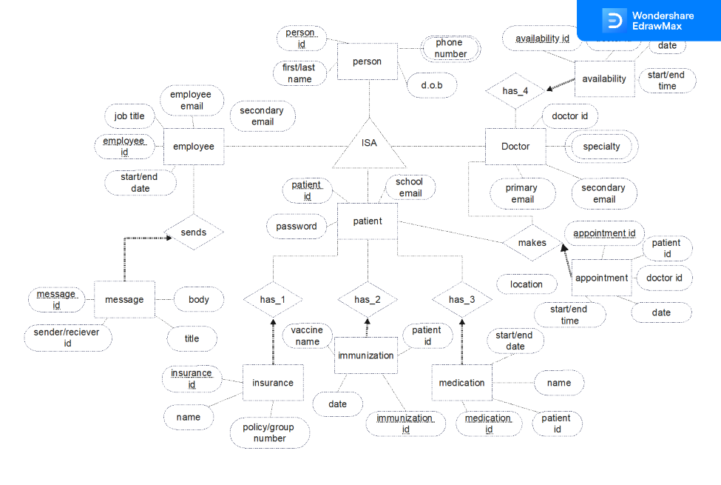
Entity-Relationship Diagram

Slide 15
Data Dictionary

Slide 16
Data Dictionary
Attribute | Data Type | Defines | Example
person_id | INT | Key for a person | 1
first_name | VARCHAR(20) | Person’s first name | Henry
middle_initial | VARCHAR(1) | Person’s middle initial (optional, defaults to blank) | W
last_name | VARCHAR(30) | Person’s last name | Ale
date_of_birth | DATE | Person’s birthday (Format: YYYY-MM-DD) | 2001-11-09
PERSON

Slide 17
Data Dictionary Cont.
Attribute | Data Type | Defines | Example
employee_id | INT | Key for an employee | 12
start_date | DATE | Date employee started (Format: YYYY-MM-DD) | 2015-02-03
end_date | DATE | Date employee ended (Format: YYYY-MM-DD) (optional, defaults to blank) | 2016-03-24
job_title | VARCHAR(30) | Employee’s job position | Secretary
employee_email | VARCHAR(50) | employees email address | abc123@hazen.com
secondary_email | VARCHAR(50) | secondary email address | Ab1123@gmail.com
EMPLOYEE

Slide 18
Data Dictionary Cont.
Attribute | Data Type | Defines | Example
patient_id | INT | Key for a patient | 9
password_hash | BINARY(64) | Hashed password for a patient | 1f6e2a9cdc81f93fc9bfefe8
school_email | VARCHAR(50) | employees email address | abc1@brockport.edu
PATIENT
DOCTOR
Attribute | Data Type | Defines | Example
patient_id | INT | Key for a patient | 9
password_hash | BINARY(64) | Hashed password for a patient | 1f6e2a9cdc81f93fc9bfefe8
school_email | VARCHAR(50) | Employee's email address | abc1@brockport.edu

Slide 19
Data Dictionary Cont.
Attribute | Data Type | Defines | Example
person_id | INT | Key for a patient | 9
telephone | VARCHAR(10) | Person’s 10-digit number | 1234567890
TELEPHONE
SPECIALTY
Attribute | Data Type | Defines | Example
doctor_id | INT | Key for doctor | 5
specialty | VARCHAR(30) | Describes what the doctor specializes | Neurology

Slide 20
Data Dictionary Cont.
Attribute | Data Type | Defines | Example
availability_id | INT | Key for availability | 3
doctor_id | INT | Key for a doctor | 1
availability_date | DATE | Date of availability (Format: yyyy-mm-dd) | 2023-01-01
start_time | TIME | HH:MI:SS | 12:00:00
end_time | TIME | HH:MI:SS | 12:30:00
DOCTOR_AVAILABILITY
APPOINTMENT
Attribute | Data Type | Defines | Example
appointment_id | INT | Key for appointment | 30
patient_id | INT | Key for a patient | 1
doctor_id | INT | Key for a doctor | 8
appointment_date | DATE | Date of the appointment (Format: yyyy-mm-dd) | 2023-01-01

Slide 21
Data Dictionary Cont.
Attribute | Data Type | Defines | Example
message_id | INT | Key for message | 57
sender_id | INT | Key for sender | 1
receiver_id | INT | Key for receiver | 8
title | VARCHAR(50) | Title of message | Reminder
body | TEXT | Message being sent | You have an appointment on 02/14/2024
MESSAGE
INSURANCE
Attribute | Data Type | Defines | Example
insurance_id | INT | Key for insurance | 25
patient_id | INT | Key for a patient | 1
name | VARCHAR(80) | Insurance Name | Blue Cross Blue Shield Association
policy_number | VARCHAR(20) | Insurance policy number | BC331FFS31S2D
group_number | VARCHAR(20) | Insurance group number | 234BX3FGH12

Slide 22
Data Dictionary Cont.
Attribute | Data Type | Defines | Example
medication_id | INT | Key for medication | 30
patient_id | INT | Key for a patient | 1
Medication_name | VARCHAR(50) | Name of medication | Adderall
start_date | DATE | Date medication started (Format: yyyy-mm-dd) | 2013-10-09
end_date | DATE | Date medication ended (Format: YYYY-MM-DD) (optional, defaults to blank) | 2013-11-09
MEDICATION
IMMUNIZATION
Attribute | Data Type | Defines | Example
immunization_id | INT | Key for immunization | 8
patient_id | INT | Key for a patient | 1
vaccine_name | VARCHAR(50) | Name of vaccine | Chickenpox Vaccination
Immunization_date | DATE | Date vaccine was given (Format: YYYY-MM-DD) | 2015-08-13

Slide 23
CONSTRAINTS

Slide 24
location: This attribute defines the location where the appointment would take place, this can be either one of the two options i.e., “Online” or “In Person”.
time: This attribute defines the time when the appointment will take place. The domain of times from which a value can be chosen for this attribute must be in between 8:00 AM to 6:00 PM.
start date: This attribute defines the start date of a medicine, and it should be between the dates from January 1950 to December 2100 (just in case).
end date: This attribute defines the end date of a medicine and it should be between the dates from January 1950 to December 2100 (just in case).

Slide 25
date: This attribute defines the date for when an immunization was taken. The value of this should be in between January 1950 to the Current Date i.e., not in the future.
availability: This attribute defines the times when a doctor is available throughout the day. The domain of times from which a value can be chosen for this attribute must be in between 8:00 AM to 6:00 PM.
Dob: This attribute defines the Date of Birth of a person. This should be in between January 1900 and January 2014.
apptDate: This attribute defines the Date when the appointment will take place. This value should be in between the current date (included) and 30 days after the current date (included).

Slide 26
The start date of a medication cannot be after the end date.
A patient cannot be scheduled for multiple appointments at the same time on the same day.
An appointment cannot be scheduled with a doctor who is not available on the given date and time.
A doctor's availability cannot overlap with their scheduled appointments.
A doctor’s specialty can be changed but not when they have any upcoming appointments already scheduled.
A message must always have a body as a message without any content would be irrelevant.
The patient can have multiple insurance entries as a person can have primary and secondary insurance carriers where the name of the insurance carriers can be the same.

Slide 27
The policy number and group number of an insurance cannot be the same.
An insurance must have a unique policy number
Information like email, first name, last name, and phone number should be set to Not Null as this
information is critical for the health records.
For the Doctor, the specialty should be set to Not Null as a Doctor must have some qualification.
An appointment must have a date and a time and thus these values should also be set to Not Null.
An Employee must contain a job title and thus this value should be set to Not Null.
All entities must have a unique primary key i.e., their Id’s for e.g., doctor id, patient id, message id, etc.

Slide 28
Constraints Test Data

Slide 29
Appointment
appointment_id | patient_id | doctor_id | appointment_date | start_time | end_time | location
11 | 21 | 1 | 2023-10-02 | 12:00:00 | 13:00:00 | Online
12 | 21 | 1 | 2023-10-02 | 12:00:00 | 13:00:00 | online
13 | 21 | 2 | 2023-10-02 | 14:00:00 | 15:00:00 | In-person
14 | 23 | 2 | 2023-10-04 | 14:00:00 | 15:00:00 | in-person
Medication
medication_id | patient_id | medication_name | start_time | end_time
11 | 21 | Larin | 2023-06-01 | 2023-03-01
12 | 21 | Aspirin |  | 2023-06-01

Slide 30
Doctor_availability
availability_id | doctor_id | appointment_date | start_time | end_time
31 | 2 | 2023-05-01 | 7:00:00 | 12:00:00
32 | 2 | 2023-05-01 | 5:00:00 | 13:00:00
33 | 2 | 2023-05-01 | 17:00:00 | 19:00:00
34 | 2 | 2023-05-01 | 18:00:00 | 17:00:00
Insurance
insurance_id | patient_id | name | policy_number | group_number
11 | 31 | Ram | ABC123456 | ABC123456
12 | 31 | Jai | 123456789 | 123456789
13 | 31 | Hari | asdfghjkl | asdfghjkl
14 | 31 | Mailn | ASDFGHJKL | ASDFGHJKL

Slide 31
Person
person_id | first_name | middle_name | last_name | birth_date
31 | Ram | Kumar | Rai | 1899-12-31
31 | Hari | Lal | Chettri | 2015-12-31
Telephone
Employee
person_id | telephone
1 | 123456789
1 | 12345678
employee_id | start_date | end_date | job_title | primary_email | secondary_email
10 | 2023-06-01 | 2023-05-01 | Job | employee@gmail.com | Null
9 | 2023-06-01 | 2023-05-31 | Job | employee@gmail.com | Null

Slide 32
Testing Procedure

Slide 33
Individual Steps Performed | Expected Result | Actual Results | Req. #
Enter this sql statement to check for appointment location: INSERT INTO `appointment` (`appointment_id`, `patient_id`, `doctor_id`, `appointment_date`, `start_time`, `end_time`, `location`) VALUES (NULL, '1234', '9876', '2023-04-30', '12:00:00', '13:00:00', 'On-line'); | Error due to wrong input for location | #4025 - CONSTRAINT `location_domain` failed for `mhealth` . `appointment` | 1
Checking doctor_availability start_constraint INSERT INTO `doctor_availability` (`availability_id`, `doctor_id`, `availability_date`, `start_time`, `end_time`) VALUES (NULL, '1', '2023-04-30', '06:00:00', '12:00:00') | Error due to availability out-off range | #4025 - CONSTRAINT `start_time_domain` failed for `mhealth`.`doctor_availability` | 6

Slide 34
Checking doctor_availability end_constraint INSERT INTO `appointment` (`appointment_id`, `patient_id`, `doctor_id`, `appointment_date`, `start_time`, `end_time`, `location`) VALUES (NULL, '1234', '9876', '2023-04-30', '12:00:00', '13:00:00', 'Online'); | Error due to availability out-off range | #1644 - Doctor is not available at the given date and time. | 6
Check person date of birth: INSERT INTO `person` (`person_id`, `first_name`, `middle_initial`, `last_name`, `birth_date`) VALUES (NULL, 'Sita', NULL, 'Rai', '1899-12-31') | Error due to date-of-birth being before 1900-01-01 | #4025 - CONSTRAINT `birth_date_domain` failed for `mhealth`.`person` | 7

Slide 35
Checking if Policy Number and Group Number are equal: INSERT INTO `insurance` (`insurance_id`, `patient_id`, `name`, `policy_number`, `group_number`) VALUES (NULL, '21', 'Ram', '1234567', '1234567') | Error due to same policy and group number | #4025 - CONSTRAINT `policy_group_chk` failed for `mhealth`.`insurance` | 5
Check in medication: INSERT INTO `medication` (`medication_id`, `patient_id`, `medication_name`, `start_date`, `end_date`) VALUES (NULL, '21', 'Advil', '2023-04-29', '2023-04-28') | Error due to start date is greater than end date | #4025 - CONSTRAINT `end_date_chk` failed for `mhealth`.`medication` | 6

Slide 36
Check employee start and end date INSERT INTO `employee` (`employee_id`, `start_date`, `end_date`, `job_title`, `primary_email`, `secondary_email`) VALUES ('1', '2023-04-29', '2023-04-28', 'Software Developer', 'ram@gmail.com', NULL) | Error due to start date is greater than end date | #4025 - CONSTRAINT `employee_end_date_chk` failed for `mhealth`.`employee` | 5
Check telephone length: INSERT INTO `telephone` (`person_id`, `telephone`) VALUES ('21', '123456789') | Error due to the length of telephone being less than 10 | #4025 - CONSTRAINT `len_number_chk` failed for `mhealth`.`telephone` | 3

Slide 37
Queries

Slide 38
Queries for Table Creation
CREATE TABLE `person` (
`person_id` INT(11) NOT NULL,
`first_name` VARCHAR(50) NOT NULL,
`middle_initial` CHAR(1) DEFAULT NULL,
`last_name` VARCHAR(50) NOT NULL,
`birth_date` DATE NOT NULL
);
CREATE TABLE `doctor` (
`doctor_id` INT(11) NOT NULL,
`primary_email` VARCHAR(50) NOT NULL,
`secondary_email` VARCHAR(50) DEFAULT NULL
);

Slide 39
CREATE TABLE `patient` (
`patient_id` INT(11) NOT NULL,
`password_hash` BINARY(64) NOT NULL,
`school_email` VARCHAR(50) NOT NULL
);
CREATE TABLE `employee` (
`employee_id` INT(11) NOT NULL,
`start_date` DATE NOT NULL,
`end_date` DATE DEFAULT NULL,
`job_title` VARCHAR(50) NOT NULL,
`primary_email` VARCHAR(50) NOT NULL,
`secondary_email` VARCHAR(50) DEFAULT NULL
);

Slide 40
Queries for Row Object Creation
1.) Create an appointment using attributes as per the APPOINTMENTS schema.
2.) Add a Doctor ID and Patient ID to a record in the Appointment table, thereby adding a Doctor to an Appointment.
3.) Return names and contact information about all Persons assigned to an Appointment.
4.) Find records of Immunizations, Medication, Insurance for the Patient of an Appointment.
5.) List names and contact information for Doctors of a given Specialty, Availability, and Time.
6.) Create a message using the attributes as per the MESSAGE schema.

Slide 41
7.) Modify an appointment record.
8.) Add a Patient ID to a record in the Immunization table, thereby adding an Immunization to a patient.
9.) Add a Patient ID to a record in the Insurance table, thereby adding an Insurance to a patient.
10.) Add a Patient ID to a record in the Medication table, thereby adding a Medication to a patient.
11.) Return time, date, and location using the appointment_id.

Slide 42
1.) Create an appointment using attributes as per the APPOINTMENTS schema
INSERT INTO appointment (appointment_id, patient_id, doctor_id, appointment_date, start_time, end_time, location)
VALUES (1, 21, 1, '2023-10-02', '10:00:00', '11:00:00', 'in-person’);
2.) Add a Doctor ID and Patient ID to a record in the Appointment table, thereby adding a Doctor to an Appointment
UPDATE appointment
SET doctor_id = 7
WHERE appointment_id = 1
UPDATE appointment
SET patient_id = 1
WHERE appointment_id = 1;
6.) Create a message using the attributes as per the MESSAGE schema
INSERT INTO message (message_id, sender_id, receiver_id, title, body)
VALUES (1, 12, 21, 'Appointment Reminder', 'Hello! This is just a reminder that you have an upcoming appointment with your doctor on May 5th at 10am. Please remember to arrive 10-15 minutes early to check in. Thank you!');
7.) Modify an appointment record
UPDATE appointment
SET doctor_id = 7
WHERE appointment_id = 1;

Slide 43
Requirement Matrix

Slide 44
Query | Req 1 | Req 2 | Req 3 | Req 4 | Req 5 | Req 6 | Req 7 | Req 8
1 | X
2 |  |  | X
3 | X |  | X
4 |  |  | X |  | X
5 |  |  |  | X

Slide 45
Query | Req 1 | Req 2 | Req 3 | Req 4 | Req 5 | Req 6 | Req 7 | Req 8
6 |  |  |  |  |  |  |  | X
7 |  | X |  |  |  |  |  | X
8 |  |  |  |  |  | X
9 |  |  |  |  |  | X | X
10 |  |  |  |  |  | X | X
11 |  | X | X

Slide 46
Views

Slide 47
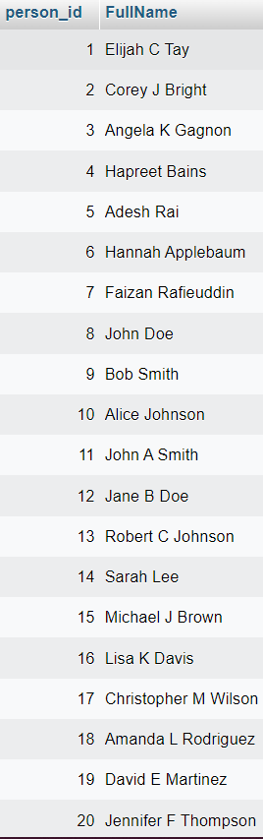
Full Name View
CREATE VIEW Full_Name AS
SELECT
p.person_id AS person_id,
IF(
(p.middle_initial IS NULL),
CONCAT(p.first_name, p.last_name),
CONCAT(p.first_name, p.middle_initial, p.last_name)
) AS FullName
FROM
.person p

Slide 48
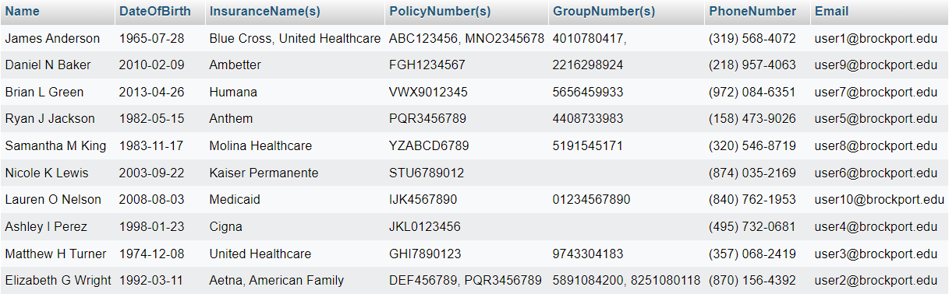
Patient Information View

Slide 49
Patient Information View SQL
CREATE VIEW Patient_Information AS
SELECT
(SELECT f.FullName FROM full_name f WHERE f.person_id = patient.patient_id) AS Name,
person.birth_date AS DateOfBirth,
GROUP_CONCAT(insurance.name SEPARATOR ', ') AS InsuranceNames,
GROUP_CONCAT(insurance.policy_number SEPARATOR ', ') AS PolicyNumbers,
GROUP_CONCAT(insurance.group_number SEPARATOR ', ') AS GroupNumbers,
(SELECT formatted_telephone.formatted_telephone FROM formatted_telephone WHERE formatted_telephone.person_id = patient.patient_id) AS PhoneNumber,
patient.school_email AS Email
FROM
patient
JOIN person ON patient.patient_id = person.person_id
JOIN telephone ON patient.patient_id = telephone.person_id
JOIN insurance ON insurance.patient_id = patient.patient_id
GROUP BY
patient.patient_id
ORDER BY
person.last_name;

Slide 50
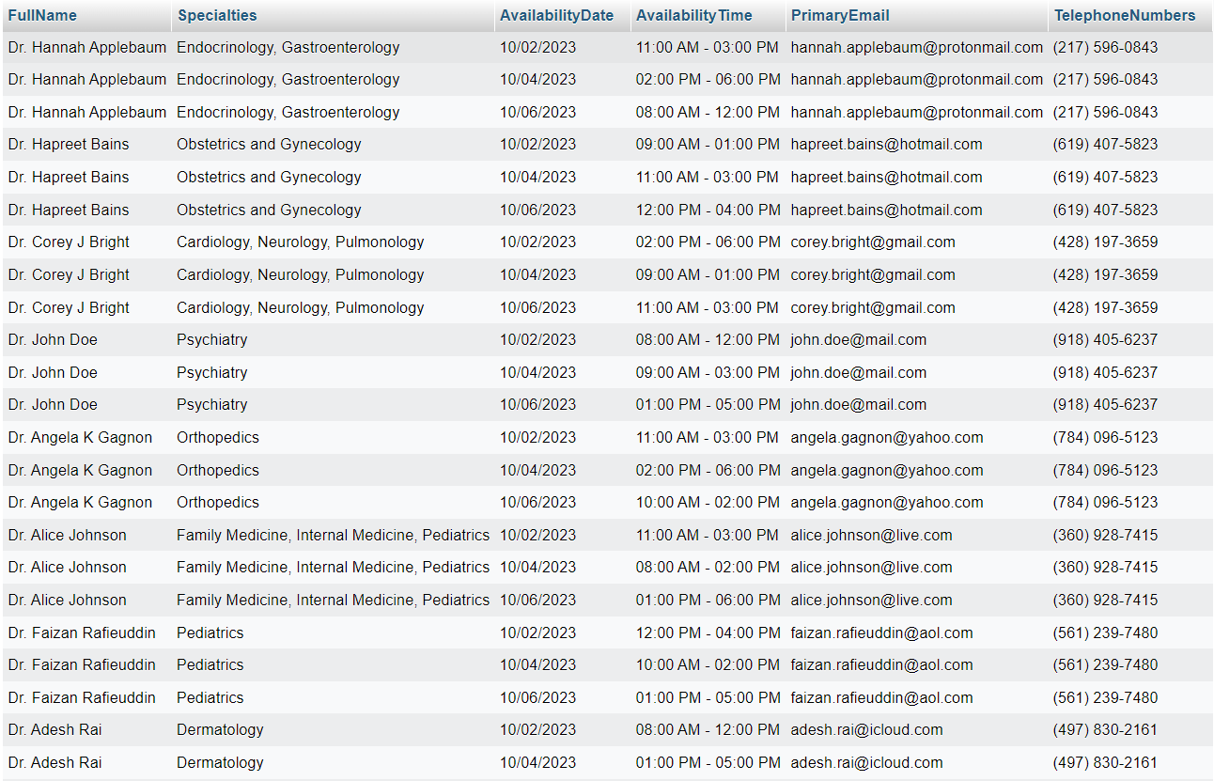
D O C T O R I N F O
V
I
E
W

Slide 51
Current Employees Information SQL
CREATE VIEW Current_Employees_Info AS
SELECT (SELECT f.FullName
FROM full_name f
WHERE (f.person_id = employee.employee_id)) AS FullName,
employee.job_title AS JobTitle,
CONCAT(
TIMESTAMPDIFF(YEAR, employee.start_date, CURDATE()), ' year(s) and ',
(TIMESTAMPDIFF(MONTH, employee.start_date, CURDATE()) % 12), ' months(s)'
) AS YearsWorked,
employee.primary_email AS PrimaryEmail,
employee.secondary_email AS SecondaryEmail,
(SELECT ft.formatted_telephone FROM formatted_telephone ft
WHERE (ft.person_id = employee.employee_id)) AS PhoneNumbers
FROM employee
JOIN person p ON p.person_id = employee.employee_id
WHERE employee.end_date IS NULL
ORDER BY p.last_name, employee.start_date;

Slide 52
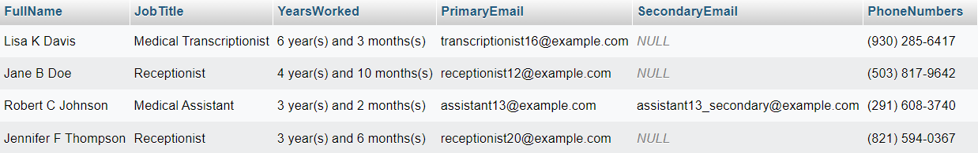
Current Employees Information
View

Slide 53
TRIGGERS

Slide 54
Prevent Availability Overlap
CREATE TRIGGER prevent_availability_overlap
BEFORE INSERT OR UPDATE
ON doctor_availability
BEGIN
DECLARE overlap_count INT;
SELECT COUNT(*) INTO overlap_count FROM doctor_availability
WHERE doctor_id = NEW.doctor_id AND availability_date = NEW.availability_date
AND start_time < NEW.end_time AND end_time > NEW.start_time;
IF overlap_count > 0 THEN
SIGNAL SQLSTATE '45000' SET MESSAGE_TEXT = 'The availability time overlaps with an existing availability.’;
END IF;
END

Slide 55
Prevent Double Booking
CREATE TRIGGER prevent_double_booking
BEFORE INSERT OR UPDATE
ON appointment
BEGIN
DECLARE num_appointments INTEGER;
SELECT COUNT(*) INTO num_appointments FROM appointment
WHERE patient_id = NEW.patient_id AND appointment_date = NEW.appointment_date
AND start_time <= NEW.end_time AND end_time >= NEW.start_time;
IF num_appointments > 0 THEN
SIGNAL SQLSTATE '45000' SET MESSAGE_TEXT = 'Cannot make two appointments during the same time frame and date.’;
END IF;
END

Slide 56
Check If Doctor Is Available
CREATE TRIGGER check_doctor_availability
BEFORE INSERT OR UPDATE
ON appointment
BEGIN
IF NOT EXISTS (
SELECT *
FROM doctor_availability
WHERE doctor_id = NEW.doctor_id
AND `availability_date` = NEW.appointment_date
AND (
(NEW.start_time BETWEEN start_time AND end_time)
AND (NEW.end_time BETWEEN start_time AND end_time))
) THEN
SIGNAL SQLSTATE '45000'
SET MESSAGE_TEXT = 'Doctor is not available at the given date and time.';
END IF;
END

Slide 57
Employee Date Trigger
CREATE TRIGGER employee_date_trigger
BEFORE INSERT OR UPDATE
ON employee
BEGIN
IF (NEW.start_date NOT BETWEEN '1950-01-01' AND CURDATE()) THEN
SIGNAL SQLSTATE '45000' SET MESSAGE_TEXT = 'Invalid start or end date.’;
END IF;
END

Slide 58
Employee Date Trigger
CREATE TRIGGER employee_date_trigger
BEFORE INSERT OR UPDATE
ON employee
BEGIN
IF (NEW.start_date NOT BETWEEN '1950-01-01' AND CURDATE()) THEN
SIGNAL SQLSTATE '45000' SET MESSAGE_TEXT = 'Invalid start or end date.’;
END IF;
END

Slide 59
TESTS

Slide 60
TEST DATA TRIGGERS

Slide 61
appointment_id | patient_id | doctor_id | appointment_date | start_time | end_time | location
1 | 32 | 1 | 2023-10-08 | 6:00:00 | 10:00:00 | in-person
2 | 54 | 4 | 2023-10-07 | 6:00:00 | 10:00:00 | online
3 | 11 | 6 | 2023-10-09 | 10:00:00 | 19:00:00 | in-person
4 | 42 | 8 | 2023-10-06 | 14:00:00 | 20:00:00 | online
5 | 77 | 10 | 2023-10-04 | 5:00:00 | 10:00:00 | in-person

Slide 62
appointment_id | patient_id | doctor_id | appointment_date | start_time | end_time | location
1 | 10 | 2 | 2023-10-05 | 9:00:00 | 10:00:00 | in-person
2 | 3 | 5 | 2023-10-05 | 9:00:00 | 10:00:00 | in-person
3 | 23 | 9 | 2023-10-16 | 12:00:00 | 13:00:00 | in-person
4 | 66 | 3 | 2023-10-16 | 12:00:00 | 13:00:00 | in-person
5 | 19 | 11 | 2023-10-16 | 12:00:00 | 13:00:00 | in-person

Slide 63
employee_id | start_date | end_date | job_title | primary_email | secondary_email
28 | 1935-11-22 | 1936-04-28 | Medical Records Clerk | xavierturner20@email.com | xavierturner202@email.com
24 | 1927-07-03 | 1941-10-16 | Medical Billing Specialist | annabellesanchez19@email.com | annabellesanchez192@email.com
18 | 1943-05-11 | 1946-01-07 | Medical Assistant | jonathanperez42@email.com | jonathanperez422@email.com
20 | 1948-09-12 | 1949-12-05 | Receptionist | mackenziebarnes67@email.com | mackenziebarnes672@email.com
25 | 1932-02-19 | 1942-11-14 | Medical Coder | johncampbell54@email.com | johncampbell542@email.com
12 | 1945-06-24 | 1949-03-25 | Medical Transcriptionist | veronicabrooks23@email.com | veronicabrooks232@email.com
17 | 1949-01-08 | 1949-02-18 | Medical Assistant | kevinscott89@email.com | kevinscott892@email.com
15 | 1939-12-31 | 1940-09-02 | Receptionist | victoriaroberts76@email.com | victoriaroberts762@email.com
22 | 1947-03-17 | 1948-08-01 | Medical Coder | christopherrodriguez28@email.com | christopherrodriguez282@email.com
14 | 1930-08-09 | 1938-12-19 | Medical Transcriptionist | madisonmiller94@email.com | madisonmiller942@email.com

Slide 64
immunization_id | patient_id | vaccine_name | immunization_date
1 | 34 | Tdap | 1949-11-14
2 | 43 | HPV | 1941-10-16
3 | 45 | MMR | 1946-01-07
4 | 22 | Hepatitis A | 1949-11-05
5 | 41 | Hepatitis B | 1942-11-14
6 | 28 | Varicella | 1931-03-25
7 | 31 | Influenza | 1940-02-18
8 | 47 | Pneumococcal | 1937-09-02
9 | 21 | Meningococcal | 1948-08-01
10 | 37 | Shingles | 1938-12-19

Slide 65
availability_id | doctor_id | availability_date | start_time | end_time
1 | 1 | 2022-10-03 | 09:00:00 | 13:00:00
2 | 1 | 2022-10-03 | 09:00:00 | 13:00:00
3 | 1 | 2022-10-07 | 08:00:00 | 12:00:00
4 | 1 | 2022-10-07 | 08:00:00 | 12:00:00
5 | 3 | 2022-10-05 | 14:00:00 | 18:00:00
6 | 2 | 2022-10-07 | 11:00:00 | 15:00:00
7 | 3 | 2022-10-03 | 11:00:00 | 15:00:00
8 | 3 | 2022-10-05 | 14:00:00 | 18:00:00
9 | 4 | 2022-10-03 | 09:00:00 | 13:00:00
10 | 4 | 2022-10-03 | 09:00:00 | 13:00:00

Slide 66
medication_id | patient_id | medication_name | start_date | end_date
1 | 23 | Aspirin | 1935-11-22 | NULL
2 | 27 | Tylenol | 1927-07-03 | NULL
3 | 18 | Advil | 1943-05-11 | 2023-07-13
4 | 25 | Lipitor | 1948-09-12 | 2023-04-10
5 | 16 | Zoloft | 1932-02-19 | NULL
6 | 12 | Prozac | 1945-06-24 | 2023-05-12
7 | 29 | Celebrex | 1949-01-08 | 2023-01-11
8 | 19 | Nexium | 1939-12-31 | 2023-05-17
9 | 11 | Zyrtec | 1947-03-17 | 2023-04-09
10 | 21 | Claritin | 1930-08-09 | 2023-04-21

Slide 67
TESTING PROCEDURE TRIGGERS

Slide 68
Individual Steps Performed | Expected Result | Actual Results | Requirements
Inserting into the immunization table with incorrect start date INSERT INTO `immunization` (`immunization_id`, `patient_id`, `vaccine_name`, `immunization_date `) VALUES (‘1’, '34', '9876', ‘Tdap’, '1949-11-14') | Will cause an error as the date taken for the immunization is before 1950 which should be detected in the insert trigger | #1644 – Invalid immunization date. Only dates between January 1950 and the current data are allowed | 5
Updating one of the records in the immunizations table with incorrect start date UPDATE immunization SET immunization_date = `1949-11-14` WHERE immunization_id = `1`; | Will cause an error as the date taken for the immunization is before 1950 which should be detected in the update trigger | #1644 – Invalid immunization date. Only dates between January 1950 and the current data are allowed | 5

Slide 69
Individual Steps Performed | Expected Result | Actual Results | Requirements
Inserting into the medication table with incorrect dates for the medication INSERT INTO `medication` (`medication_id`, `patient_id`, `medication_name`, `start_date`, `end_date`) VALUES (`1`, '23', `Asprin`, `1935-11-22`, NULL) | Will cause an error as the start date for the medication is before 1950 which should be detected in the insert trigger | #1644 – Invalid start date. Only dates between January 1950 and the current date are allowed | 5
Updating a record in the medication table with incorrect start and end dates. UPDATE medication SET start_date = `1935-11-22` WHERE medication_id = `1`; | Will cause an error as the start date for the medication is before 1950 which should be detected in the update trigger | #1644 – Invalid start date. Only dates between January 1950 and the current date are allowed | 5

Slide 70
Individual Steps Performed | Expected Result | Actual Results | Requirements
Inserting into the appointment table with date that is out of bounds INSERT INTO `appointment` (`appointment_id`, `patient_id`, `doctor_id`, `appointment_date`, `start_time`, `end_time`, `location`) VALUES (`1`, '32', '1', '2023-10-08', '6:00:00', '10:00:00', 'in-person'); | Will cause an error as the start time of the appointment is before 09:00:00 AM which should be detected in the insert trigger | #1644 – Doctor is not available at the given date and time | 1
Updating a record in the appointment table with date that is out of bounds UPDATE appointment SET start_time = `6:00:00` WHERE appointment_id = `1`; | Will cause an error as the start time of the appointment is before 09:00:00 AM which should be detected in the update trigger | #1644 – Doctor is not available at the given date and time | 1

Slide 71
Individual Steps Performed | Expected Result | Actual Results | Requirements
Inserting into the appointment table with date, start, and end times similar to one of the records already present in the table INSERT INTO `appointment` (`appointment_id`, `patient_id`, `doctor_id`, `appointment_date`, `start_time`, `end_time`, `location`) VALUES (`4`, '66', '3', '2023-10-16', '12:00:00', '13:00:00', 'in-person'); | Should cause an error as this insert trigger would detect double bookings i.e., more than one booking about to take place on the same date, start, and end times | Does not cause an error and the query gets accepted which is unusual behavior. This was caused by a missing string in the trigger which was fixed | 1
Updating a record in the appointments table with date, start, and end times similar to one of the records already present in the table UPDATE appointment SET appointment_date = `2023-10-16`, start_time = `12:00:00`, end_time = `13:00:00` WHERE appointment_id = `1`; | Should cause an error as this update trigger would detect double bookings i.e., more than one booking about to take place on the same date, start, and end times | Does not cause an error and the query gets accepted which is unusual behavior. This was caused by a missing string in the trigger which was fixed. | 1

Slide 72

QUESTIONS?

